Slide 1
Ch. 7 Accounting from Kimball and Ross
IDS 521

Slide 2
Key concepts in this chapter
Bus matrix snippet for accounting processes
General ledger periodic snapshots and journal transactions
Chart of accounts
Period close
Year-to-date facts
Multiple ﬁscal accounting calendars
Drilling down through a multi-ledger hierarchy
Budgeting chain and associated processes
Fixed depth position hierarchies
Slightly ragged, variable depth hierarchies
Totally ragged hierarchies of indeterminate depth using a bridge table and alternative modeling techniques
Shared ownership in a ragged hierarchy
Time varying ragged hierarchies
Consolidated fact tables that combine metrics from multiple business processes

Slide 3
General Journal Entry and Ledger
General journal records firm’s transactions. It is organized in a chronological order.
Journal entry is a sort of business diary. To learn about specific business transactions, managers refer to the journal entries.
General ledger is a collection of the firm's accounts. It is organized by account.
General ledger accounts are divided into five types of categories: assets, liabilities, income, expense, and equity.
To provide a clear picture of how each account is affected by a transaction, the journal entry is posted to the ledger accounts.
The purpose of posting is to show the impact of business transaction on the individual accounts.
To learn the current balance of important accounts, managers will look to the ledger accounts.

Slide 4
Posting Journal Entries to the Ledger Accounts
General Journal Entries
Date | Account Names | Debit | Credit
9/1/2015 | Cash | 7500
 | Capital |  | 7500
9/8/2015 | Raw Materials | 2500
 | Accounts Payable |  | 2500
9/15/2015 | Accounts Payable | 1000
 | Cash |  | 1000
General Ledger (T-Accounts)
Cash |  |  |  |  | Raw Materials
Date | Debit | Date | Credit |  | Date | Debit | Date | Credit
9/1/2015 | 7500 | 9/15/2015 | 1000 |  | 9/8/2015 | 2500
Capital |  |  |  |  | Accounts Payable
Date | Debit | Date | Credit |  | Date | Debit | Date | Credit
 |  | 9/1/2015 | 7500 |  | 9/15/2015 | 1000 | 9/8/2015 | 2500

Slide 5
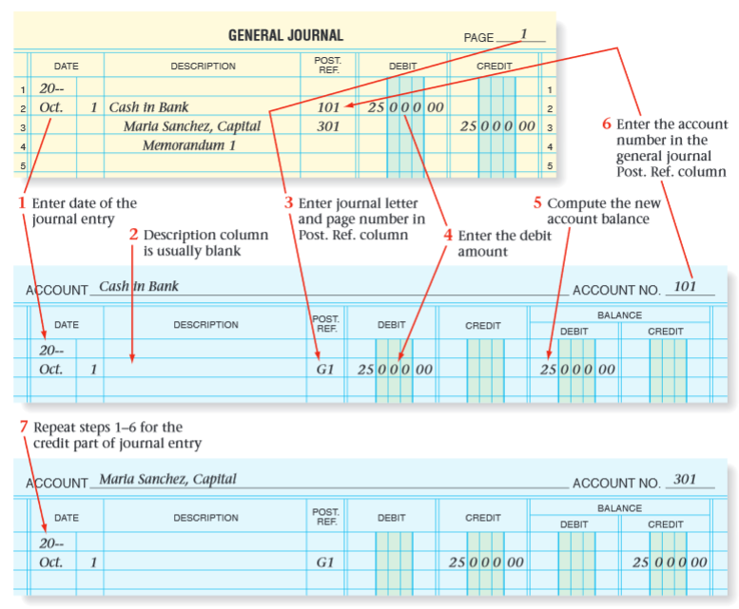
Posting Journal entries to the Ledger Accounts (cont.)
Source: mrhaworth.weebly.com/uploads/2/8/0/8/2808974/glencoe_accounting_chp7.pdf

Slide 6
Chart of Accounts
The cornerstone of the general ledger is the chart of accounts.
The ledger’s chart of accounts is the epitome of an intelligent key:
For example, account numbers from 1,000 through 1,999 might be asset accounts, whereas account numbers ranging from 2,000 to 2,999 may identify liabilities.

Slide 7
Chart of Accounts
The chart of accounts likely associates the organization cost center with the account.
Typically, the organization attributes provide a complete rollup from cost center to department to division.
The chart of accounts naturally decomposes into two dimensions.
One dimension represents accounts in the general ledger.
the other dimension represents the organization rollup.

Slide 8
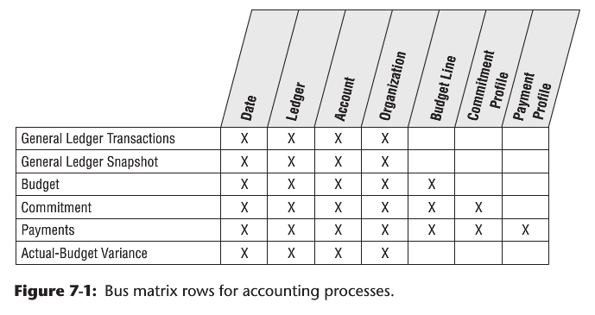
Bus Matrix for Accounting Processes
Notes:
The dimensions associated with accounting processes, such as the general ledger account or organizational cost center, are frequently used solely by these
processes, unlike the core customer, product, and employee dimensions which are used repeatedly across many diverse business processes.

Slide 9
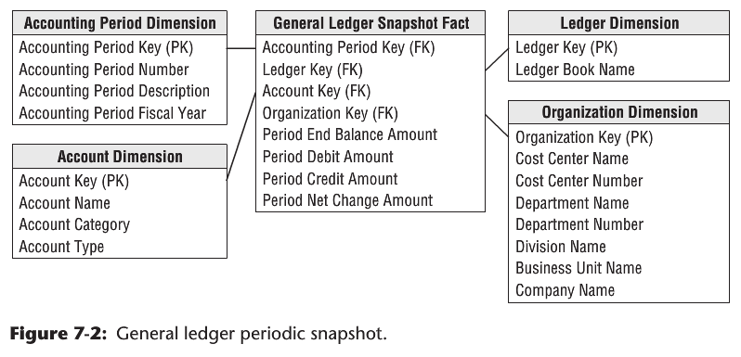
GL Account Balances at the End of Accounting Period
Notes:
-What is the grain of the Fact table? One row per accounting period for the most granular level in the general ledger’s chart of accounts.
-The general ledger account balances at the end of each accounting period would be very useful for many kinds of ﬁnancial analyses, such as account rankings, trending patterns, and period-to-period comparisons.
-In this snapshot fact table, the balance amount is a semi-additive fact. Although the balance doesn’t represent G/L activity, we include the fact in the design because it is so useful. Otherwise, you would need to go back to the beginning of time to calculate an accurate end-of-period balance.
-The ledger dimension is a convenient and intuitive dimension that enables multiple ledgers to be stored in the same fact table. However, every query that accesses this fact table must constrain the ledger dimension to a single value (for example, Final Approved Domestic Ledger) or the queries will double
count values from the various ledgers in this table. The best way to deploy this schema is to release separate views to the business users with the ledger dimension pre-constrained to a single value.

Slide 10
Year-to-Date Facts?
Designers are often tempted to store “to-date” columns in fact tables. They think it would be helpful to store quarter-to-date or year-to-date additive totals on each fact row so they don’t need to calculate them.
Remember that numeric facts must be consistent with the grain. To-date facts are not true to the grain and are fraught with peril.
When fact rows are queried and summarized in arbitrary ways, these untrue-to-the-grain facts produce nonsensical, overstated results.

Slide 11
Multiple Currencies
If the general ledger consolidates data that has been captured in multiple currencies, you would handle it much as we discussed in Order Management (see Chapter 6):
Represent the facts both in terms of the local currency, as well as a standardized corporate currency.
Each fact table row would represent one set of fact amounts expressed in local currency and a separate set of fact amounts on the same row expressed in the equivalent corporate currency.

Slide 12
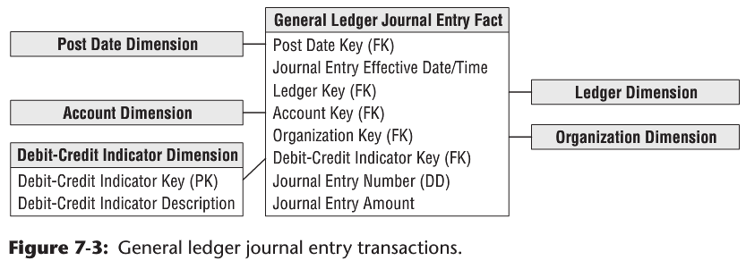
GL Journal Transactions
Notes:
The grain of the fact table is one row for every general ledger journal entry transaction.
The journal entry number is a degenerate dimension with no linkage to an associated dimension table.
If the journal entry numbers from the source are ordered, then this degenerate dimension can be used to order the journal entries because the calendar date dimension on this fact table is too coarse to provide this sorting.
If the journal entry numbers do not easily support the sort, then an effective date/time stamp must be added to the fact table.
Each row in the journal entry fact table is identiﬁed as either a credit or a debit. The debit/credit indicator takes on two, and only two, values.

Slide 13
Multiple Fiscal Accounting Calendars
In Figure 7-3, the data is captured by posting date, but users may also want to summarize the data by ﬁscal account period.
Unfortunately, ﬁscal accounting periods often do not align with standard Gregorian calendar months.
For example, a company may have 13 4-week accounting periods in a ﬁscal year that begins on September 1 rather than 12 monthly periods beginning on January 1.
If you deal with a single ﬁscal calendar, then each day in a year corresponds to a single calendar month, as well as a single accounting period. Given these relationships, the calendar and accounting periods are merely hierarchical attributes on the daily date dimension.
The daily date dimension table would simultaneously conform to a calendar month dimension table, as well as to a ﬁscal accounting period dimension table.

Slide 14
Multiple Fiscal Accounting Calendars (cont.)
In other situations, you may deal with multiple ﬁscal accounting calendars that vary by subsidiary or line of business.
If the number of unique ﬁscal calendars is a ﬁxed, low number, then you can include each set of uniquely labeled ﬁscal calendar attributes on a single date dimension.
For example, a given row in the daily date dimension would be identiﬁed as belonging to accounting period 1 for subsidiary A but accounting period 7 for subsidiary B.

Slide 15
Multiple Fiscal Accounting Calendars (cont.)
In a more complex situation with a large number of different ﬁscal calendars, you could identify the official corporate ﬁscal calendar in the date dimension.
You then have several options to address the subsidiary-speciﬁc ﬁscal calendars. The most common approach is to create a date dimension outrigger with a multipart key consisting of the date and subsidiary keys.
There would be one row in this table for each day for each subsidiary. The attributes in this outrigger would consist of ﬁscal groupings (such as ﬁscal week end date and ﬁscal period end date).
You would need a mechanism for ﬁltering on a speciﬁc subsidiary in the outrigger. Doing so through a view would then allow the outrigger to be presented as if it were logically part of the date dimension table.

Slide 16
Multiple Ledgers in a Hierarchy
Very large enterprises or government agencies may have multiple ledgers arranged in an ascending hierarchy, perhaps by enterprise, division, and department.
At the lowest level, department ledger entries may be consolidated to roll up to a single division ledger entry. Then the division ledger entries may be consolidated to the enterprise level.
One way to model this hierarchy is by introducing the parent snapshot’s fact table surrogate key in the fact table, as shown in Figure 7-4 (see next slide).
In this case, because you deﬁne a parent/child relationship between rows, you add an explicit fact table surrogate key, a single column numeric identiﬁer incremented as you add rows to the fact table.

Slide 17
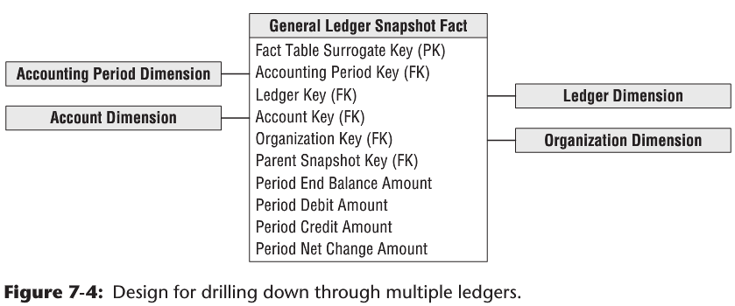
Multiple Ledgers in a Hierarchy (cont.)

Slide 18
Multiple Ledgers in a Hierarchy (cont.)
You can use the parent snapshot surrogate key to drill down in your multilayer general ledger.
Suppose that you detect a large travel amount at the top level of the ledger:
You grab the surrogate key for that high-level entry and then fetch all the entries whose parent snapshot key equals that key. This exposes the entries at the next lower level that contribute to the original high-level record of interest.

Slide 19
Multiple Ledgers in a Hierarchy (cont.)
The SQL would look like this:
Select * from GL_Fact where Parent_Snapshot_key =
(Select fact_table_surrogate_key from GL_Fact f, Account a
where <joins> and a.Account = 'Travel' and f.Amount > 1000)

Slide 20
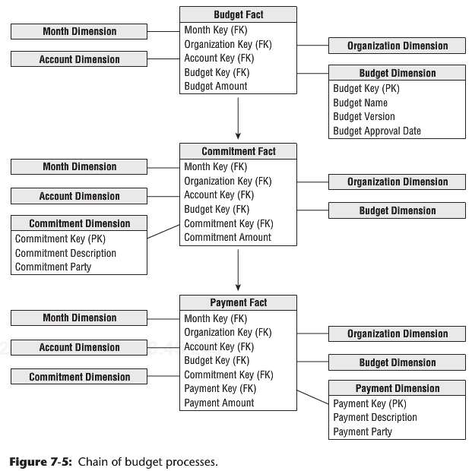
Budgeting Process
Notes:
As a dimensional modeler, you can view the budgeting chain as a series of fact tables, as shown in Figure 7-5. This chain consists of a budget fact table, commitments fact table, and payments fact table, where there is a logical ﬂow that starts with a budget being established for each organization and each account. Then during the operational period, commitments are made against the budgets, and ﬁnally payments are made against those commitments.

Slide 21
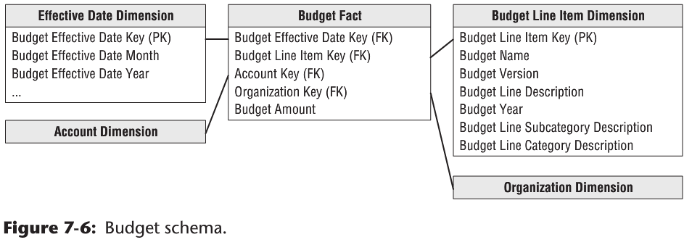
Budget Schema
Notes:
-What is the grain of the Budget Fact table? The net change of the budget line item in an organizational cost center that occurred during the month.
-A possible complication regarding the account dimension is that sometimes a single budget line item impacts more than one G/L account. In that case, you would need to allocate the budget line to the individual G/L accounts. Because the grain of the budget fact table is by G/L account, a single budget line for a cost center may be represented as several rows in the fact table.
-The budget line item identiﬁes the purpose of the proposed spending, such as employee wages or office supplies.
-The effective month is the month during which the budget changes are posted. The ﬁrst entries for a given budget year would show the effective month when the budget is ﬁrst approved. If the budget is updated or modiﬁed as the budget year gets underway, the effective months would occur during the budget year. If you don’t adjust a budget throughout the year, then the only entries would be the ﬁrst ones when the budget is initially approved. This is what is meant when the grain is speciﬁed to be the net change. It’s critical that you understand this point, or you won’t understand what is in this budget fact table or how it’s used.
- If the budget amount for a given budget line and account is modiﬁed during the year, an additional row is added to the budget fact table representing the net change. For example, if the original budget were $200,000, you might have another row in June for a $40,000 increase and then another in October for a negative $25,000 as you tighten your belt going into year-end.

Slide 22
Budget Schema (cont.)
With this design, you can create a number of interesting analyses:
To look at the current budgeted amount by department and line item, you can constrain on all dates up to the present, adding the amounts by department and line item.
To ask for all the changes to the budget for various line items, simply constrain on a single month. You’ll report only those line items that experienced a change during the month.
To compare current commitments to the current budget, separately sum the commitment amounts and budget amounts from the beginning of time to the current date. Then combine the two answer sets on the row headers.

Slide 23
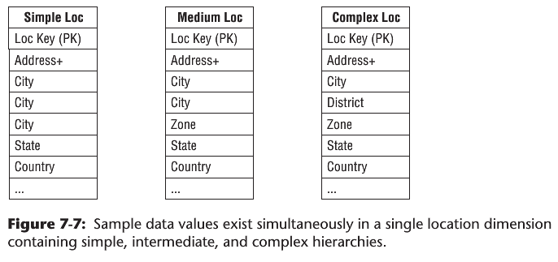
Dimension Attribute Hierarchies
Fixed Depth Positional Hierarchies
day ➪ month ➪ year
Slightly Ragged Variable Depth Hierarchies

Slide 24
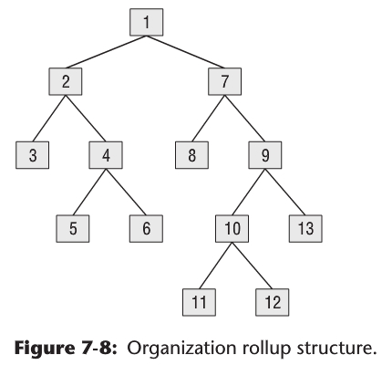
Dimension Attribute Hierarchies (cont.)
Ragged Variable Depth Hierarchies

Slide 25
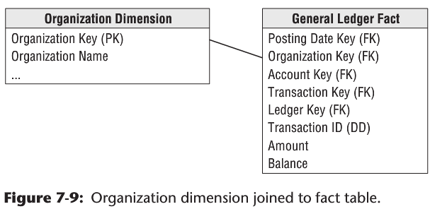
Simple Join Between the Organization Dimension and the Fact Table

Slide 26
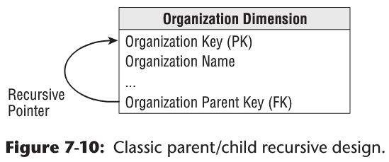
Classic Parent/Child Tree Structure

Slide 27
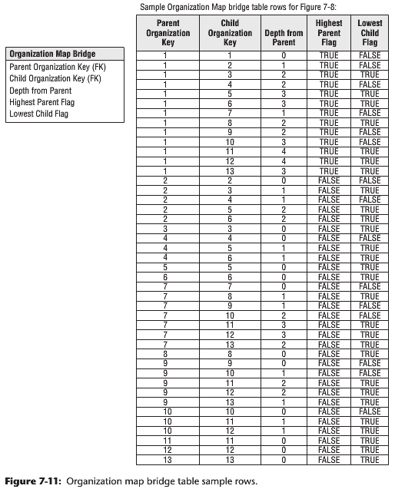
A Special Map Bridge Table

Slide 28
Advantages of the Bridge Table Approach for Ragged Hierarchies
Alternative rollup structures to be selected at query time
Shared ownership rollups
Time varying ragged hierarchies
Limited impact when nodes undergo slowly changing dimension (SCD) type 2 changes
Limited impact when the tree structure is changed

Slide 29
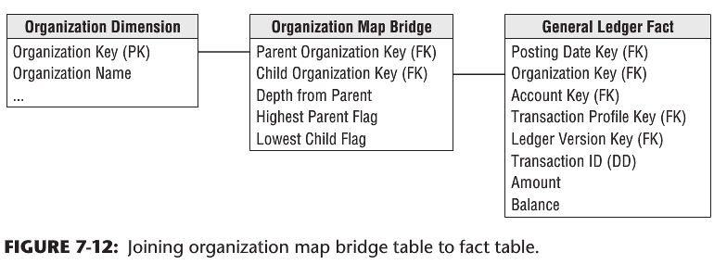
Using Organization Map Bridge
Notes:
If you constrain the organization dimension table to a single row, you can join the dimension table to the map table to the fact table, as shown in Figure 7-12. For example, if you constrain the organization table to node number 1 and simply fetch an additive fact from the fact table, you get 13 hits on the fact table, which traverses the entire tree in a single query. If you perform the same query except constrain the map table lowest child ﬂag to true, then you fetch only the additive fact from the six leaf nodes, numbers 3, 5, 6, 8, 11, 12, and 13.

Slide 30
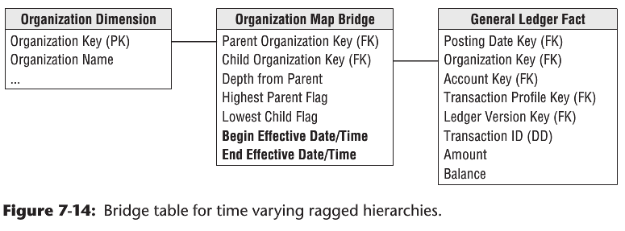
Time Varying Ragged Hierarchies

Slide 31
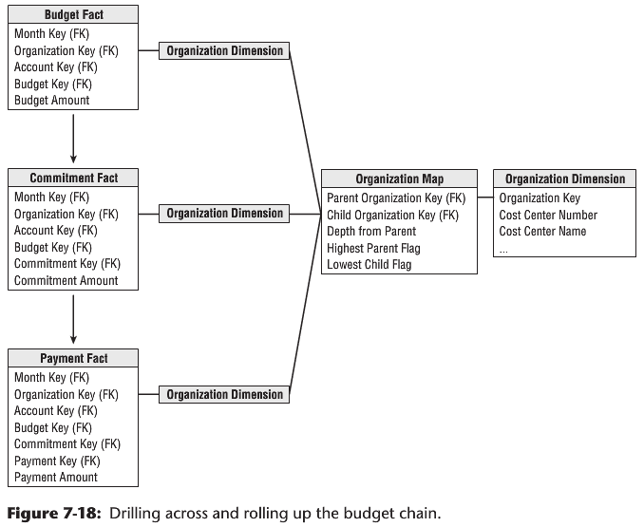
Using Organization Map Bridge to Fetch Facts Across Three Fact Tables in the Budget Chain

Slide 32
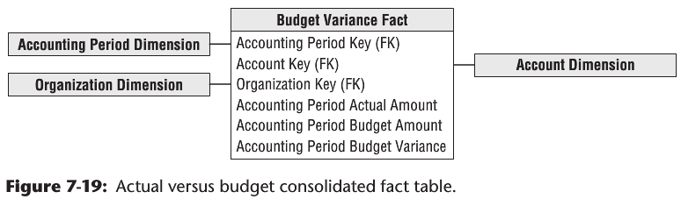
Consolidated Fact Table

